Slide 1



Harnessing advanced scientific computing

Slide 2



PARALLEL
MATRIX
MULTIPLICATION
-IN PYTHON

Slide 3
TEAM MATES :
♤ Rithika 927623BAD091
♤ Rooba 927623BAD092
♤ E.Ruthuvarshan 927623BAD093

Slide 4


Problem statement :
1)Develop a Python program to compare the performance of sequential and parallel matrix multiplication algorithms.
2)Given two randomly generated matrices A (dimensions mxk) and B (dimensions kxn), the program aims to measure the execution time of both sequential and parallel matrix multiplication methods.
3) The parallel method should utilize multiprocessing to distribute the computation across multiple CPU cores effectively.
4)The program should output the execution times of both methods and verify the correctness of the results.
5)The goal is to demonstrate the efficiency gains of parallelism in large-scale matrix multiplication tasks.

Slide 5

Abstract :
This Python program explores the performance benefits of
parallelism in matrix multiplication.
It compares the execution time of sequential and parallel matrix
multiplication algorithms using randomly generated matrices.
The parallel method leverages multiprocessing
to distribute computation across multiple CPU cores.
The program measures and contrasts the execution times of
both methods and verifies result correctness.
Through this analysis, it demonstrates the potential efficiency
gains achieved through parallelism in large-scale matrix operations.

Slide 6

1. Define matrix multiplication function.
2. Split matrices into chunks.
3. Utilize multiprocessing for parallel
computation.
4. Concatenate results.
5. Measure execution time for both sequential
and parallel methods.
6. Verify result correctness.
7. Output performance comparison.
Proposed Solution :

Slide 7
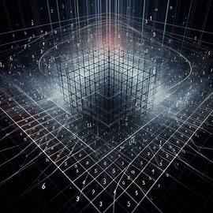







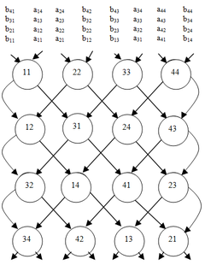



Real time applications :
- Parallel matrix multiplication finds practical use in:
- Scientific simulations
- Machine learning
- Image processing
- Optimization
- Big data analytics
- It accelerates computations by:
- Distributing tasks across multiple processors or cores
This speeds up tasks like:
- Solving linear equations
- Training neural networks
- Processing images
- Optimizing algorithms
- Analyzing large datasets
- Its application leads to faster and more scalable solutions in diverse fields such as:
- Physics - Finance
- Data-driven decision-making

Slide 8
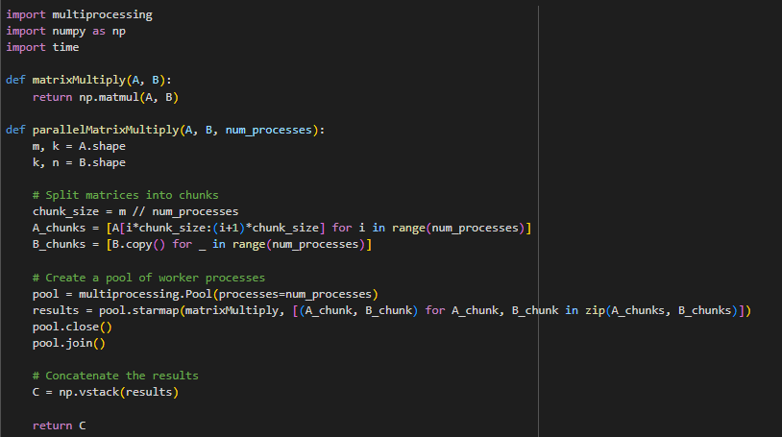
Python program for Parallel matrix multiplication :

Slide 9
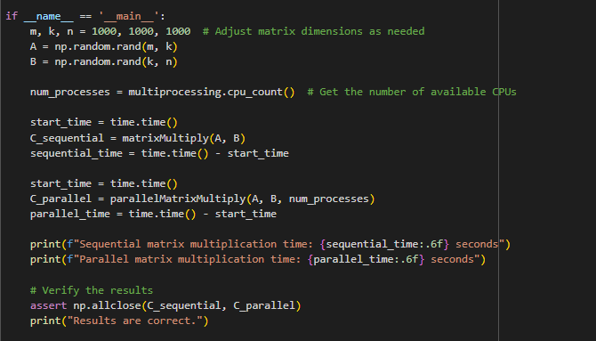


Slide 10

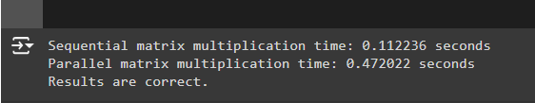
Output :

Slide 11






THANK YOU
For this
wonderful opportunity..!

